Slide 1
Example
Use the k-means algorithm and Euclidean distance to cluster the following 8 examples into 3 clusters: A1=(2,10), A2=(2,5), A3=(8,4), A4=(5,8), A5=(7,5), A6=(6,4), A7=(1,2), A8=(4,9).
Assuming A1, A4 and A7 as the initial seeds (centers of each cluster), show the results of K-means for 1 iteration.
You need to mention
The new clusters (i.e. the examples belonging to each cluster)
The centers of the new clusters

Slide 2
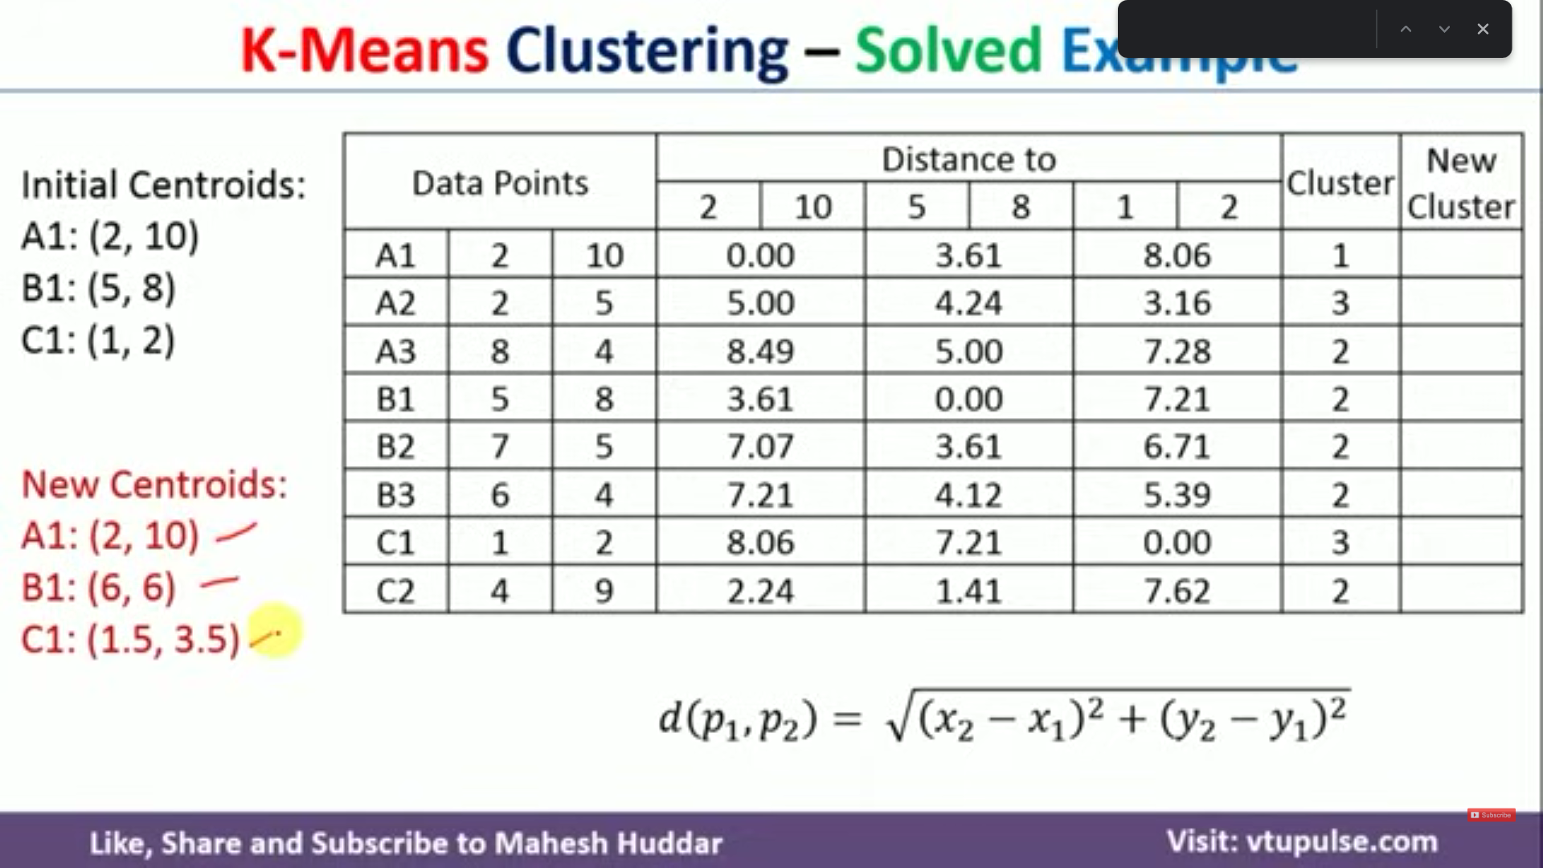
For each data point (A1 TO C2), find the distance bw them to initial centroids (A1(2,10), A4(5,8),A7(1,2)).
Next find the minimum value and allot the cluster number to the value (say in A1, 0.00 is MIN and belongs to cluster 1)
To find news centroids, since there is only one value for cluster 1: A1 new = (2,10)
Since there are 5 values for cluster 2, we find the mean of x coordinates = (8+5+7+6+4)/5 = 6 and mean of y coordinates = (4+8+5+4+9)/5 = 6: B1 new = (6,6) Similarly C1 new = (1.5,3.5)

Slide 3
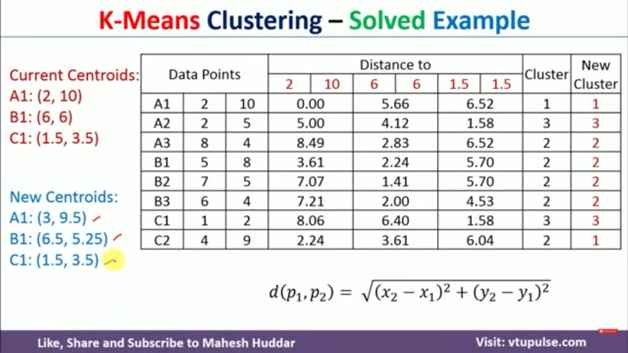
Cluster from prev dataset
Cluster from new dataset
As you can see prev cluster != new cluster so repeat the process using new found centroids

Slide 4
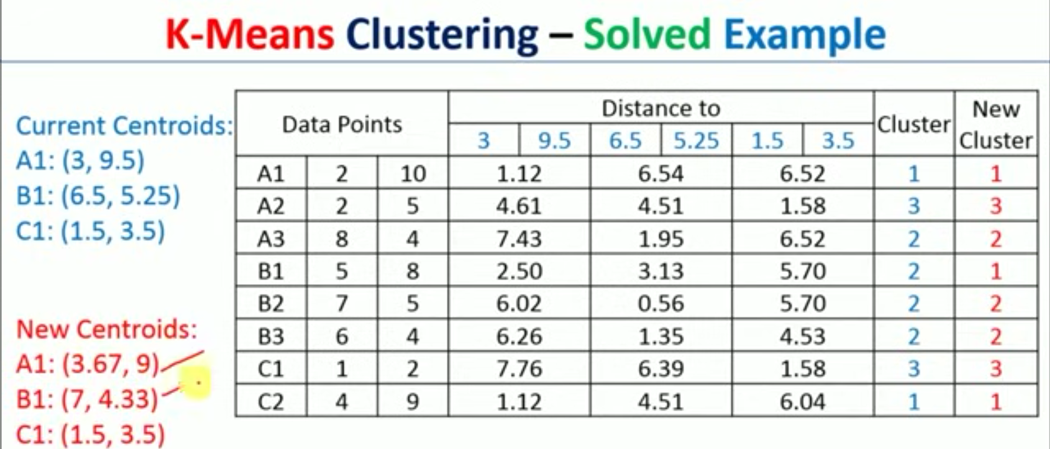
As you can see prev cluster != new cluster so repeat the process using new found centroids

Slide 5
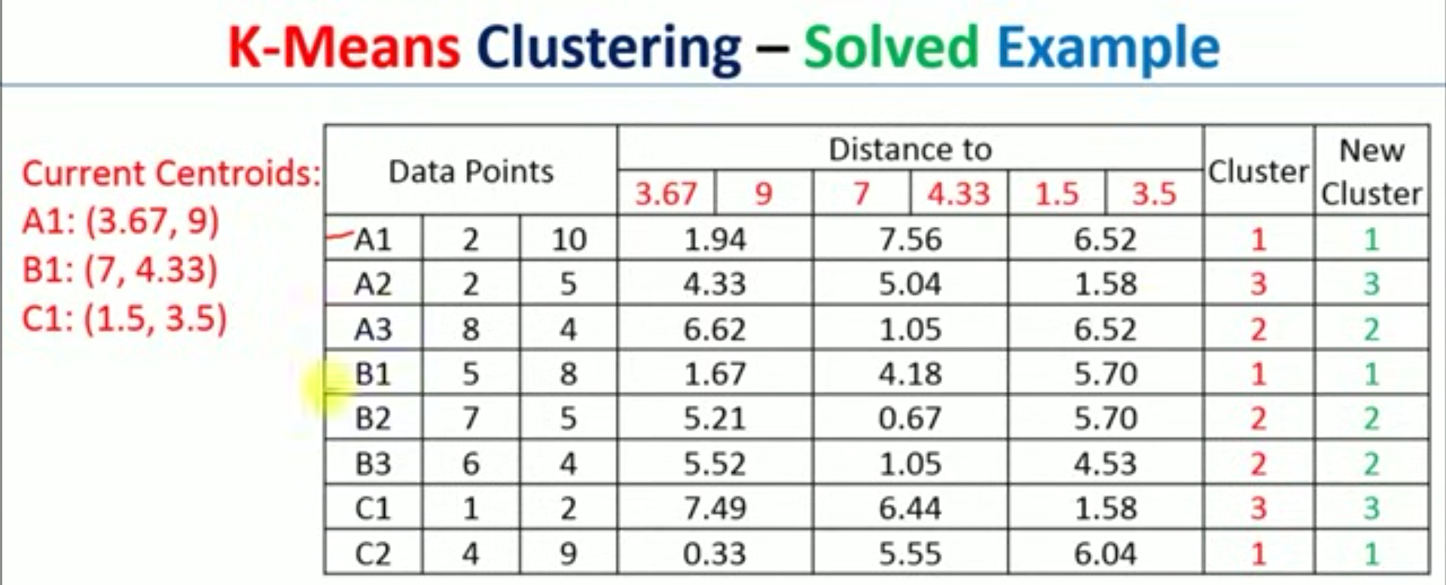
As you can see prev cluster = new cluster so current centroids = final centroids

Slide 6
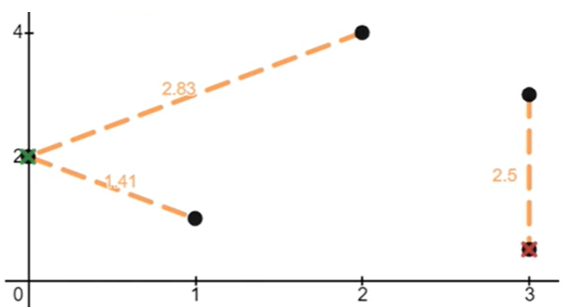
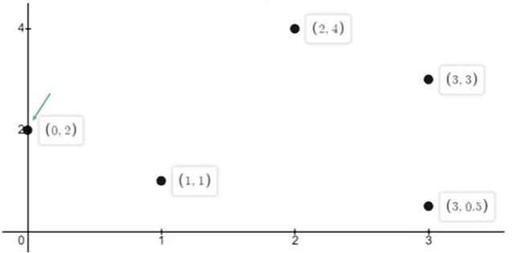
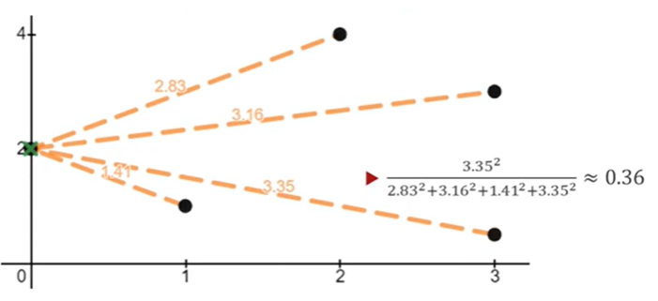
K-means++
In standard K-means, initial centroids are chosen randomly from the data points, which can lead to suboptimal solutions or slow convergence. K-means++ improves this initialization step by selecting initial centroids that are more likely to be distant from each other, thus providing a better starting point for the optimization process.
Find distance from center c1 to every other points and take the point having max distance as next center.
Third center
Choose first center randomly
Second center

Slide 7
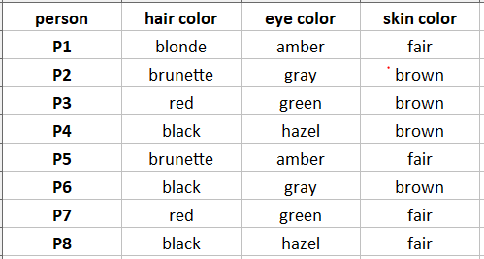
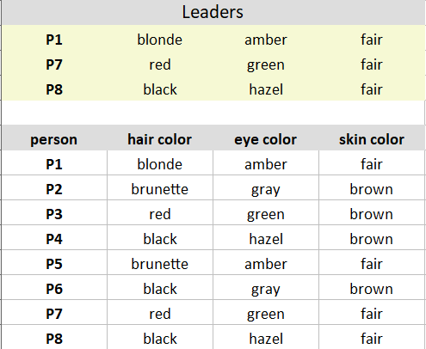
K-modes Clustering Algorithm for Categorical data
https://youtu.be/b39_vipRkUo?si=DdG8tE5AaXH4gH2e
Pick K observations at random and use them as leaders/clusters

Slide 8
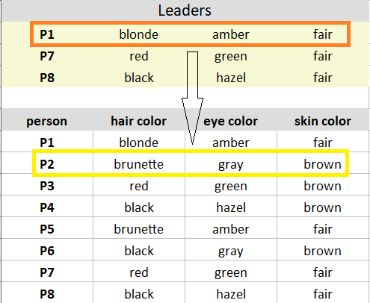
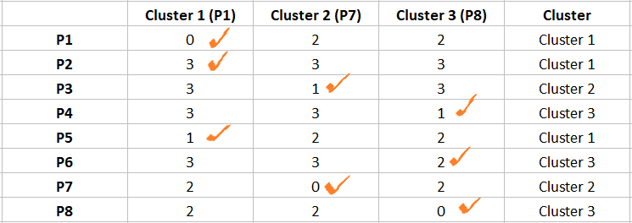
Calculate the dissimilarities(no. of mismatches) and assign each observation to its closest cluster
Comparing leader/cluster P1 to the observation P1 gives 0+0+0 = 0 dissimilarities.
Comparing leader/cluster P1 to the observation P2 gives 1+1+1 = 3 dissimilarities.
Similarly calculate for all other cluster and find the MIN from all 3 clusters

Slide 9
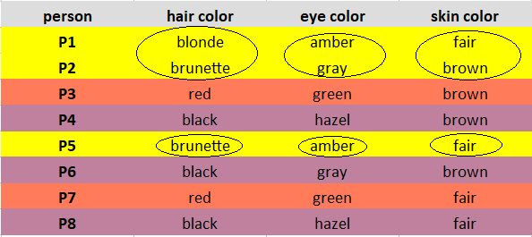
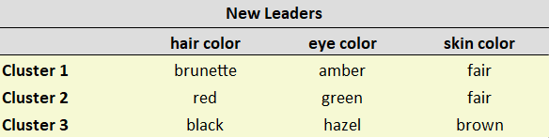
Compute new leaders (centroids): Mode is simply the most observed value.
Cluster 1 observations(P1, P2, P5) has brunette as the most observed hair color, amber as the most observed eye color, and fair as the most observed skin color.
Cluster 2 observations(P3, P7) has red as the most observed hair color, green as the most observed eye color, and brown/fair as the most observed skin color (select any)
Cluster 3 observations(P4, P6, P8) has black as the most observed hair color, hazel as the most observed eye color, and brown as the most observed skin color (select any)
Therefore new centroids are:

Slide 10
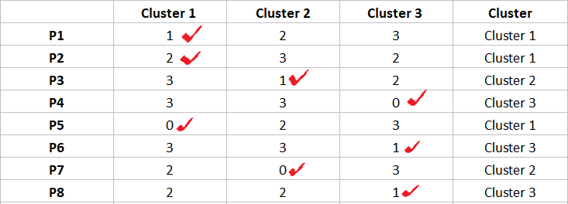
Iteration-2
The observations P1, P2, P5 are assigned to Cluster 1; P3, P7 are assigned to Cluster 2; and P4, P6, P8 are assigned to Cluster 3.

